Slide 1
JAVA Lecture 15
Multithreading in Java

Slide 2
What is Multithreading?
Multithreading is the ability to execute multiple threads in parallel within a program.
Each thread represents a separate execution path.
Why Use Multithreading?
✅ Better CPU utilization – Runs tasks in parallel.
✅ Faster execution – Reduces program execution time.
✅ Smooth user experience – Used in real-time applications (GUI, games).
Example Use Cases:
Web browsers loading multiple pages.
Music players playing songs while downloading files.

Slide 3
Difference Between Processes and Threads
Feature | Process | Thread
Definition | Independent program execution | Part of a process
Memory Usage | Uses separate memory space | Shares process memory
Execution Speed | Slower (heavyweight) | Faster (lightweight)
Communication | Inter-process communication needed | Direct memory
Example:
• Process: Running Chrome and VS Code separately.
• Threads: Running multiple tabs inside Chrome.

Slide 4
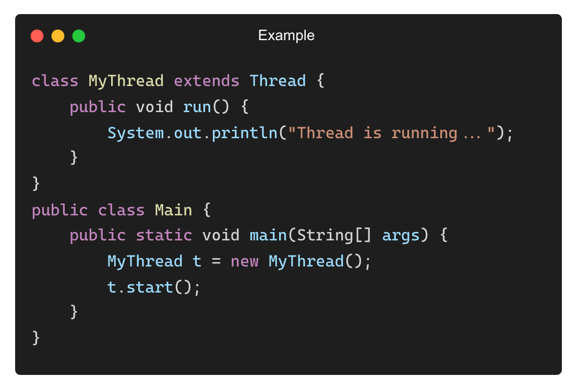
How Java Supports Multithreading
Java provides built-in support for multithreading via the java.lang.Thread class.
Ways to create threads in Java:
1. Extending Thread class
2. Implementing Runnable interface
• Basic Syntax for Creating a Thread:
Output:
Thread is running...

Slide 5
Advantages of Multithreading
✅ Improves performance → Executes tasks in parallel.
✅ Efficient resource sharing → Threads share the same memory space.
✅ Better user experience → UI remains responsive.
✅ Simplifies complex applications → Useful in real-time systems.
Example:
• Without threads: One task must finish before another starts.
• With threads: Multiple tasks execute simultaneously.

Slide 6
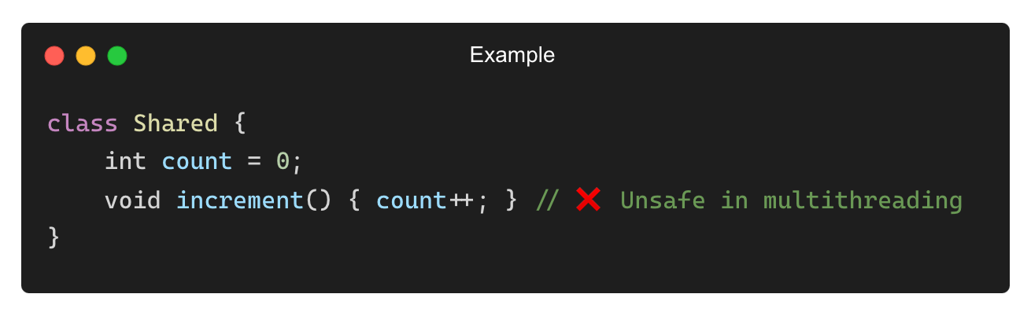
Challenges in Multithreading
❌ Race conditions – Multiple threads modifying shared data.
❌ Deadlocks – Two threads waiting for each other indefinitely.
❌ Thread starvation – Low-priority threads never execute.
❌ Synchronization issues – Data inconsistency in shared memory.
Example (Race Condition Issue):

Slide 7
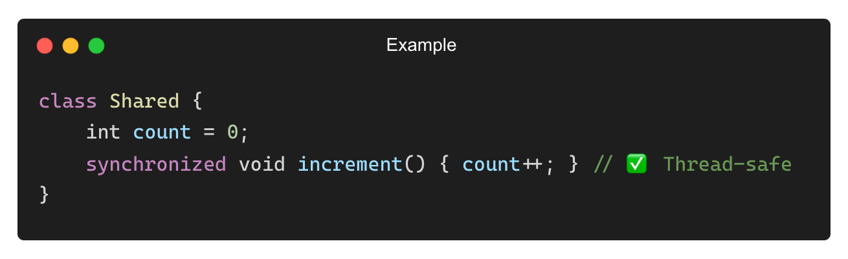
Best Practices for Using Multithreading
✅ Use synchronization to prevent race conditions.
✅ Avoid unnecessary thread creation to optimize memory usage.
✅ Use thread-safe collections like ConcurrentHashMap.
✅ Handle exceptions properly to prevent unexpected crashes.
Example (Using synchronized to Prevent Race Condition):

Slide 8
Ways to Create a Thread in Java
Java provides two primary methods to create a thread:
1. Extending the Thread class
2. Implementing the Runnable interface
Choosing the Right Approach:
✅ Use Thread class → If a thread requires full control over execution.
✅ Use Runnable interface → If the class should extend another class.

Slide 9
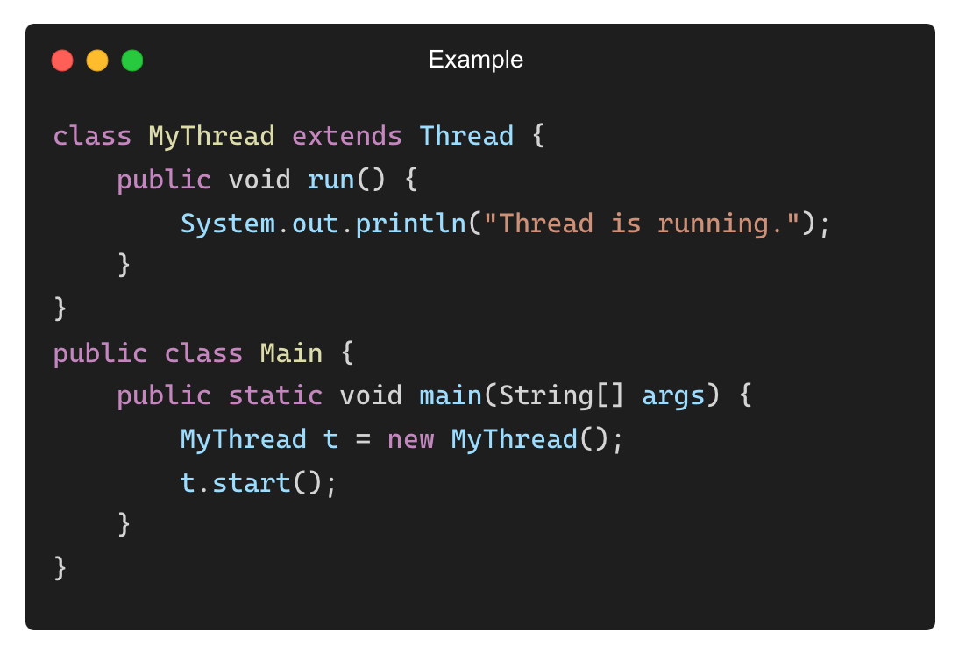
Creating a Thread by Extending the Thread Class
• Steps:
1. Extend the Thread class.
2. Override the run() method.
3. Create an object and call start().
Output:
Thread is running.

Slide 10
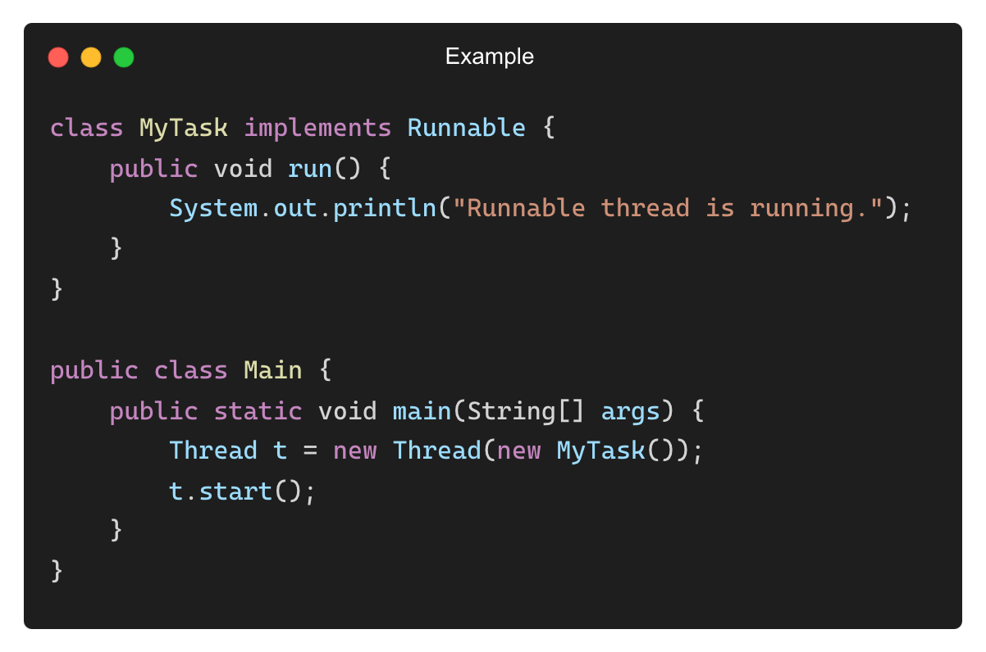
Creating a Thread by Implementing Runnable Interface
Steps:
1. Implement the Runnable interface.
2. Define the run() method.
3. Pass an instance to Thread and call start().
Output:
Runnable thread is running.

Slide 11
Differences Between Thread and Runnable Approaches
Feature | Extending Thread | Implementing Runnable
Extensibility | Cannot extend another class | Can extend another class
Reusability | Less reusable | More reusable
Resource Sharing | Each thread has its own object | Can share the same object
Recommendation: Prefer Runnable when designing modular, scalable applications.

Slide 12
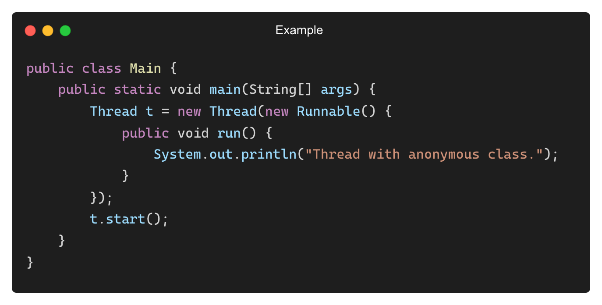
Using Anonymous Classes to Create Threads
Java allows thread creation without separate classes using anonymous classes.
Output:
Thread with anonymous class.

Slide 13
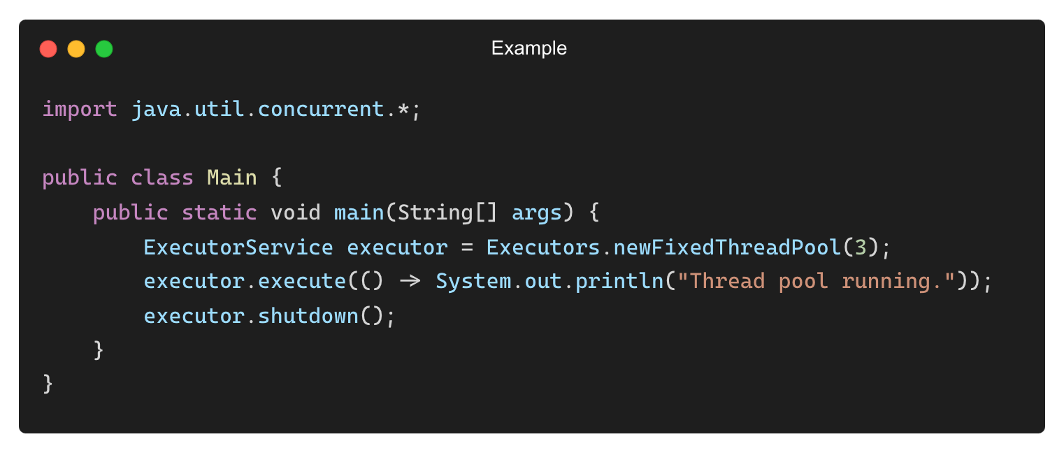
Best Practices for Creating Threads
✅ Use Runnable for better reusability and flexibility.
✅ Minimize the number of threads to avoid performance issues.
✅ Avoid blocking operations inside run() to maintain efficiency.
✅ Use thread pools (ExecutorService) for managing multiple threads efficiently.
Example (Using ExecutorService for Thread Management):
Output:
Thread pool running.

Slide 14
THANK YOU

